Slide 1
CS152 Discussion Section 1
Intro
Microprogramming
Lab 1 Overview

Slide 2
Agenda
Admin
Architecture vs Microarchitecture
Microcoding overview
Lab 1 overview
Open questions/OH

Slide 3
Your GSIs
Albert Ou
aou@eecs.berkeley.edu
OH: Mondays 11 AM - 12 PM, see Piazza for link
PhD student (advised by Krste Asanovic)
Research Focus: Vector architectures, data-parallel architectures
CS152 survivor from long ago: 2012
Jerry Zhao
jzh@berkeley.edu
OH: Tuesdays 3-4 PM, see Piazza for link
PhD student (advised by Krste Asanovic)
Research Focus: Out-of-order architecture
CS152 survivor from less long ago: 2018

Slide 4
Discussion Structure
~1 hour discussion
Review lecture material from that week
Work through example problems together (Links to blank worksheets on course website)
Feel free to interrupt with questions anytime
Remaining time used for anything
Intro to labs
Office hours
Review exams
Follow-up on interesting topics

Slide 5
Admin
Problem Set 1 due Mon Feb 8th
Lab 1 due Wed Feb 17th
Submit through Gradescope
https://www.gradescope.com/courses/232732
Check course webpage for schedule
Find partners for labs
See Piazza find-a-group post
Optional, but may save you time

Slide 6
Architecture vs Microarchitecture
“The term architecture is used here to describe the attributes of a system as seen by the programmer, i.e., the conceptual structure and functional behavior, as distinct from the organization of the data flow and control, the logic design, and the physical implementation.”
G. M. Amdahl, G. A. Blaauw, and F. P. Brooks, “Architecture of the IBM System/360,” IBM Journal of Research and Development, vol. 8, no. 2, pp. 87–101, Apr. 1964

Slide 7
Architecture
Architecture: The instruction set
What are some examples of ISAs? Your laptop? Your phone? Your TV? Your game console?
Why might a company create a closed-source architecture?
Microarchitecture: The implementation of an architecture
Is it necessarily hardware?
What might be the fastest implementation of RISC-V publically available?
Why might a company create a closed-source microarchitecture?

Slide 8
What is architecturally visible?
Instructions modify architecturally-visible state to do work
Is the following exposed by the architecture? (True/False)
Register file entries in a classic RISC machine
Stack in a stack architecture
Pipeline registers
Branch-delay slots
NOPs
Pipeline bubbles
Condition codes, status flags
Memory address width
Instruction/data caches

Slide 9
Classifying ISAs
Addressing mode: How operands are identified in an instruction
RISC: Load-store register architecture
Only load/store instructions access memory
All other instructions are register-register or register-immediate
CISC: Not RISC
Generally a highly orthogonal instruction set - many different addressing modes
i386 memory operand: reg + reg*scale + imm8/32 (scale can be 1, 2, 4, 8)
VAX: each operand specifier can be 1 to 17 (!) bytes long
Stack: No explicit registers, operands are kept on a stack
Accumulator: One implicit special register as both source and destination

Slide 10
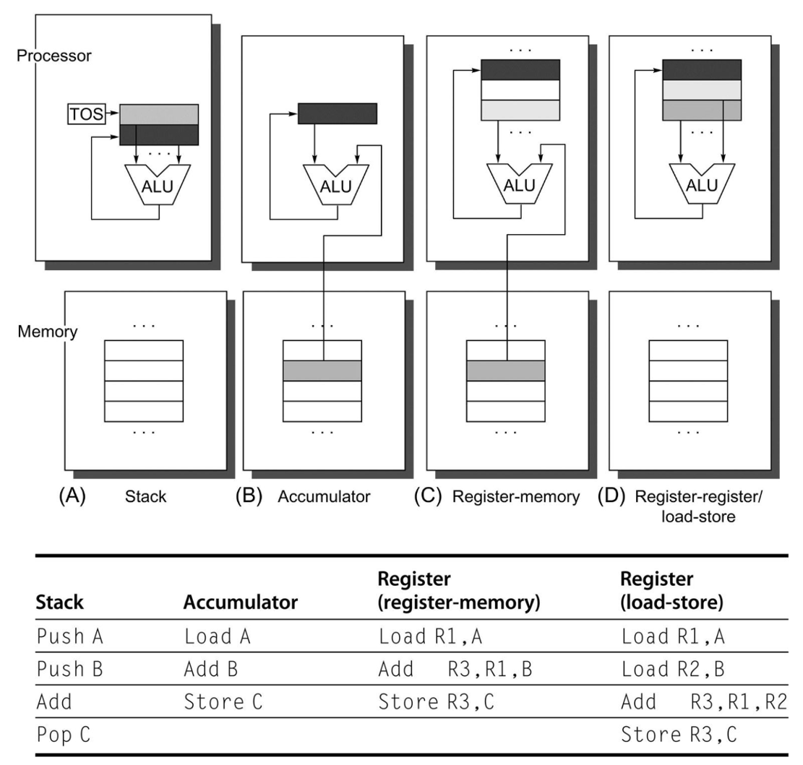
Classifying ISAs
C = A + B where A, B, C are values in memory
(Appendix A of the textbook)

Slide 11
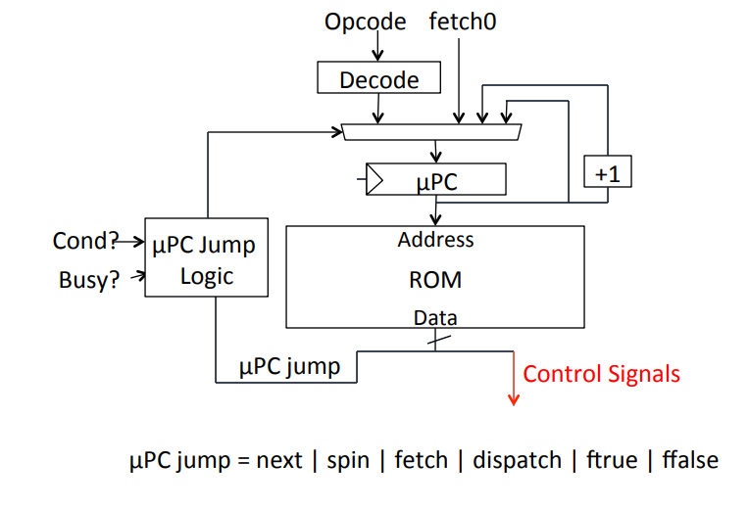
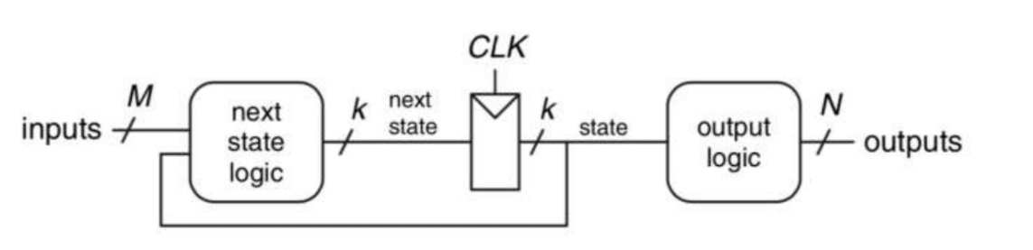
Microprogramming
Separation of datapath (arithmetic, data movement) from control (sequencing of operations on datapath)
Microcode program is essentially a description of a finite state machine for the control of a datapath
What is the state?
What are the outputs?
What is the output logic?
What is the input?
What is the next state logic?

Slide 12
Microcoded vs Pipelined
How does a microcoded single-bus machine differ from a classic RISC pipeline?
Consider how instruction execution phases are implemented
Instruction Fetch
Decode
Register Read
ALU operations
Memory operations
Register writebacks
Next PC calculation
Why is a simpler microarchitecture generally possible with microcoding?

Slide 13
Historical Context
Why did microcoding make sense historically?
ROM was cheaper and faster than logic
Simplified control complexity (helps verification)
CISC yielded better code density
(Do these still hold true today?)
Recurring theme in architecture:
Design choices are influenced by the limitations of available circuit technology
Re-evaluation becomes necessary as technology changes
Avoid repeating past mistakes. . . but also know when old lessons may not apply

Slide 14
A Simple Microcoded Control Scheme

Slide 15
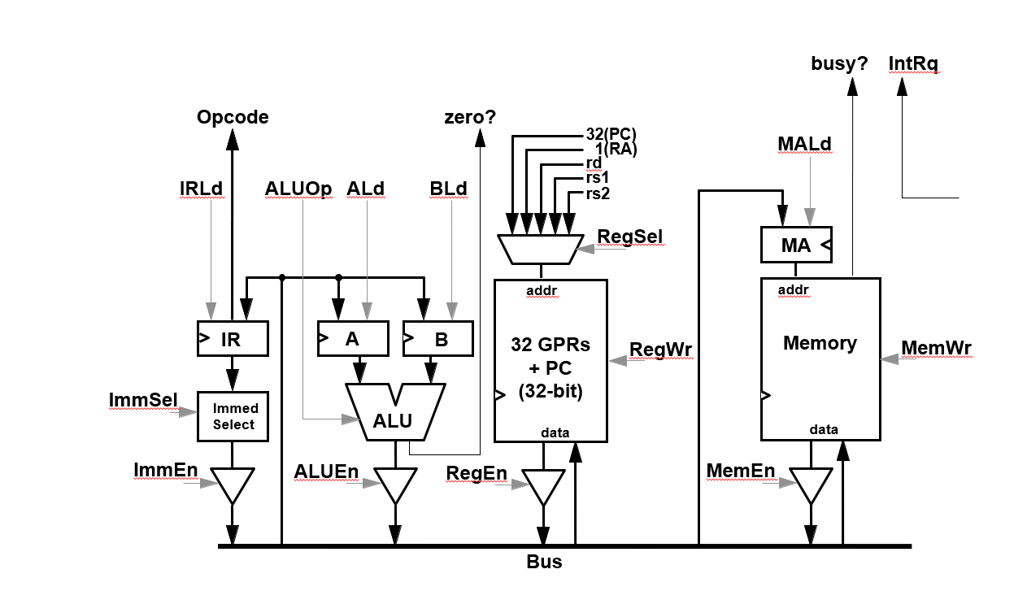
A Single-bus Microcoded Datapath

Slide 16
Microprogramming
Implement a conditional memory-to-memory move instruction in microcode for the single-bus RISC-V machine described in Handout #1. The instruction has the following format:
CMOVM (rd), (rs1), rs2
CMOVM performs the following operation: If the value in rs2 is true (non-zero), then the memory word loaded from the address in rs1 is stored to the address in rd.
if R[rs2] != 0 M[R[rd]] := M[R[rs1]]

Slide 17
State | Pseudocode | ldIR | Reg Sel | RegWr | en Reg | ldA | ldB | ALU Op | en ALU | ld MA | MemWr | en Mem | Imm Sel | en Imm | μBr | Next State
FETCH0 | MA := PC; A := PC | * | PC | 0 | 1 | 1 | * | * | 0 | 1 | 0 | 0 | * | 0 | N | *
 | IR := Mem | 1 | * | 0 | 0 | 0 | * | * | 0 | 0 | 0 | 1 | * | 0 | S | *
 | PC := A + 4 | 0 | PC | 1 | 0 | 0 | * | INC_A_4 | 1 | * | 0 | 0 | * | 0 | D | *
...
NOP0 | μBr to FETCH0 | * | * | 0 | 0 | * | * | * | 0 | * | 0 | 0 | * | 0 | J | FETCH0
CMOVM0:
if R[rs2] != 0 M[R[rd]] := M[R[rs1]]

Slide 18
State | Pseudocode | ldIR | Reg Sel | RegWr | en Reg | ldA | ldB | ALU Op | en ALU | ld MA | MemWr | en Mem | Imm Sel | en Imm | μBr | Next State
FETCH0 | MA := PC; A := PC | * | PC | 0 | 1 | 1 | * | * | 0 | 1 | 0 | 0 | * | 0 | N | *
 | IR := Mem | 1 | * | 0 | 0 | 0 | * | * | 0 | 0 | 0 | 1 | * | 0 | S | *
 | PC := A + 4 | 0 | PC | 1 | 0 | 0 | * | INC_A_4 | 1 | * | 0 | 0 | * | 0 | D | *
...
NOP0 | μBr to FETCH0 | * | * | 0 | 0 | * | * | * | 0 | * | 0 | 0 | * | 0 | J | FETCH0
CMOVM0:
if R[rs2] != 0 M[R[rd]] := M[R[rs1]]

Slide 19
Lab Logistics
CS152 partitioned into 5 modules
1 problem set per module (1.5 weeks per problem set)
1 lab per module (2.5 weeks per lab)
Labs are “take-home” assignments… (this was written pre-pandemic)
No dedicated lab sessions (sometimes we will use end of discussion)
Lab infrastructure pre-installed on instructional Linux EDA machines
Log in through ssh
TODO for you:
Request EECS instructional account
https://acropolis.cs.berkeley.edu/~account/webacct/

Slide 20
Lab Reports
Lab reports must be typed in readable English - no raw dumps!
Directed portion
Complete independently
Submit one report per person on Gradescope
Open-ended portion
Pick one problem to do
Work in groups of 1-3
Submit one report on Gradescope (< 6 pages)

Slide 21
Lab Feedback
Write as much or as little as desired.
Point deduction if omitted
Answer team feedback questions
Append feedback to individual report
We care about your feedback!
Scope of class precludes design projects
We want labs to be interesting, but not tedious

Slide 22
Lab 1
Due on Wed Feb 17
Start early! Some steps may take longer than expected
Gentle introduction to simulation and software tools
Given source code for simple processor designs
Build cycle-accurate RTL simulators
Run benchmarks, gather data, analyze data
Make recommendations, write adversarial code, propose new designs

Slide 23

Lab Infrastructure
CS152 labs are built on current research infrastructure (designs, tools, flows)
Developed from scratch at UC Berkeley over past 10 years
We will strive to use real hardware implementations wherever possible
More interesting than a contrived pure-software model
Enables more realistic experiments
Actual systems sometimes exhibit counter-intuitive behavior

Slide 24

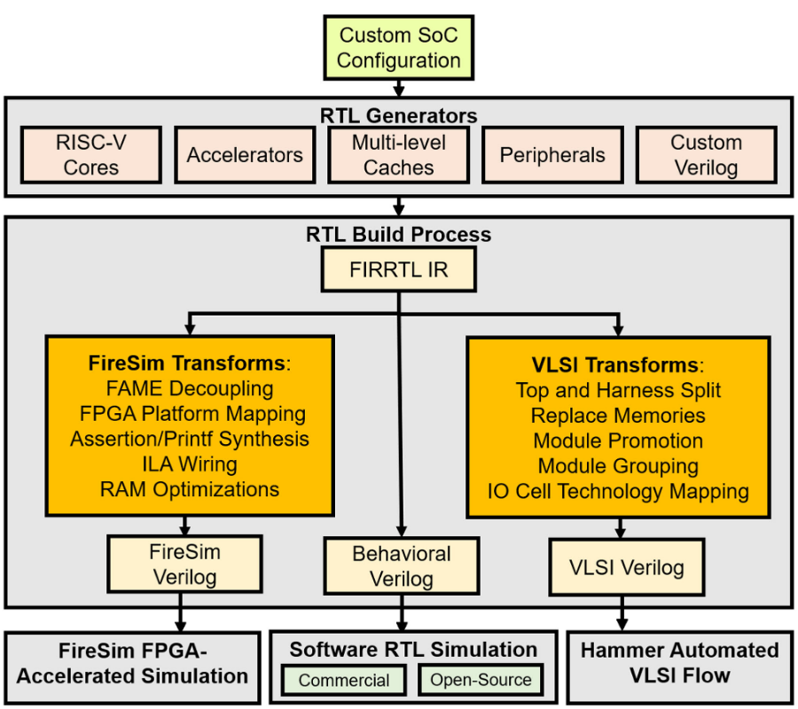
Chipyard
Integrated environment for designing system-on-chips (SoCs)
Educational Sodor cores
In-order, out-of-order cores
Accelerators, caches
Multicore
Your labs will all run in Chipyard

Slide 25
Chisel
New hardware description language designed at UC Berkeley
Embedded in Scala
Designers write Scala programs that generate hardware
Compiler framework elaborates Scala source into Verilog RTL
Elegant, concise, powerful compared to Verilog
NOTE: Students will NOT be required to implement hardware in Chisel!
Processor designs will be provided, you will need to parameterize
Can choose to write Chisel RTL for some lab open-ended questions
Students are encouraged to try to read the Chisel source

Slide 26
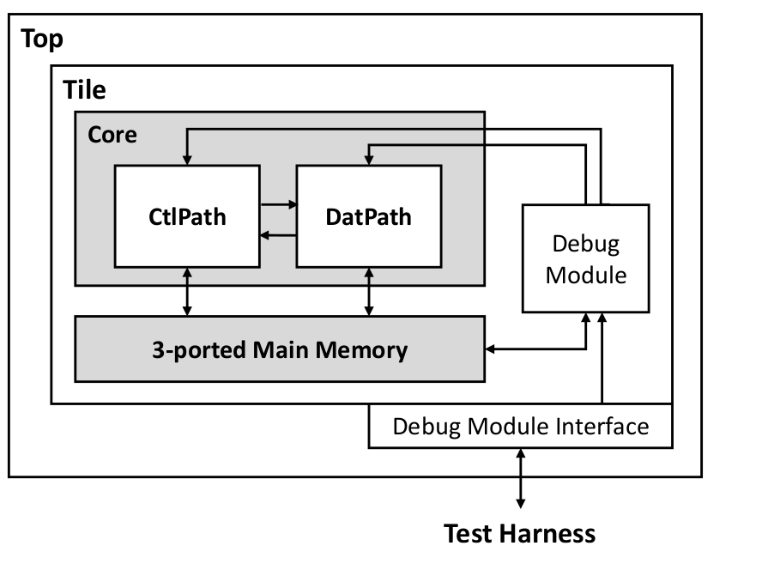
Sodor
Collection of educational RV32I cores
1-stage, 2-stage, 3-stage, 5-stage
Microcoded bus-based design
Educational, favors clarity over power/perf/area
~1000 LoC per core

Slide 27
Using TMUX for Labs
Labs will involve running simulations of real SoCs for millions of cycles
These simulations are slow, don’t let your simulation get killed by a bad internet connection
Use TMUX!
Create tmux session: tmux
Detach from tmux session: ctrl-b d
Attach to tmux session: tmux a -t <id>
Ex: tmux a -t 0

Slide 28
Lab Walkthrough

